Slide 1


AI Agents vs. Agentic AI: A Conceptual taxonomy, applications and challenges
Ranjan Sapkota, Konstantinos I. Roumeliotis, Manoj Karkee.
Adeyinka Olurin

Slide 2
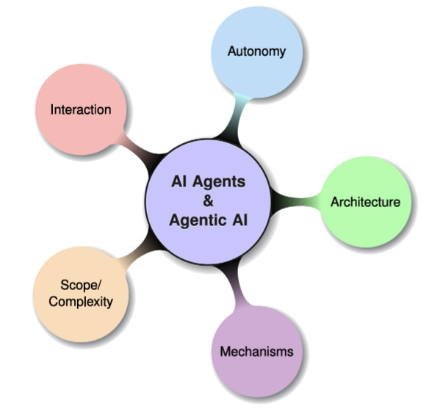
Introduction
This review distinguishes AI Agents from Agentic AI through a structured taxonomy, application mapping, and analysis of their differing design philosophies and capabilities. It establishes further foundational definitions and describes AI Agents as modular systems powered by LLMs and LIMs for tax focused automation. A comparative analysis traces their evolution, mechanisms, interaction styles, and levels of autonomy. The Agentic AI’s used in research, robotics, and medical decision making. Finally, It identifies challenges like hallucination, brittleness, emergent behavior, and coordination failure, proposing solutions including ReAct, RAG, coordination layers, and causal modelling.
Fig 1. Mind map of this research for exploring concepts, applications and challenges of AI Agents and Agentic AI.

Slide 3
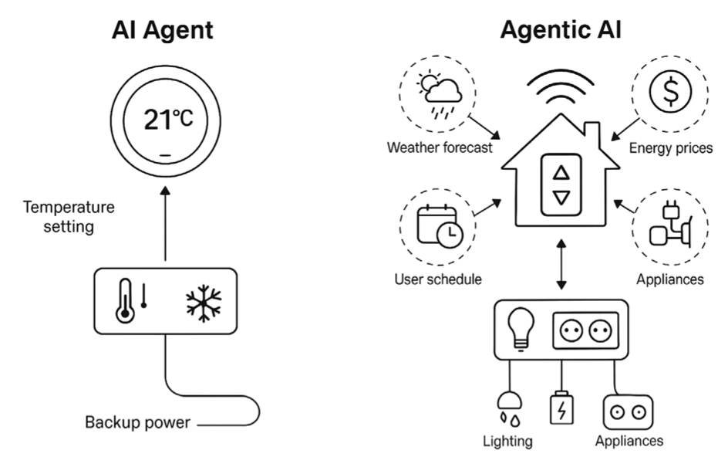
AI Agents vs Agentic AI
Feature | AI Agents | Agentic AI
Definition | Autonomous software programs that perform specific tasks. | Systems of multiple AI agents collaborating to achieve complex goals.
Autonomy Level | High autonomy within specific tasks. Broad level of autonomy with the ability to manage multi-step, complex tasks and systems. | High autonomy within specific tasks. Broad level of autonomy with the ability to manage multi-step, complex tasks and systems.
Tax Complexity | Typically handle single, specific tasks. | Handle complex, multi-step tasks requiring coordination.
Collaboration | Operate independently. | Involve multi-agent information sharing, collaboration and cooperation.
Learning and Adaptation | Learn and adapt within their specific domain. | Learn and adapt across a wider range of tasks and environments.
Applications | Customer service chatbots, virtual assistants, automated workflows. | Supply chain management, business process optimization, virtual project managers.
Fig 2. Comparative illustration of AI Agent versus Agentic AI.

Slide 4
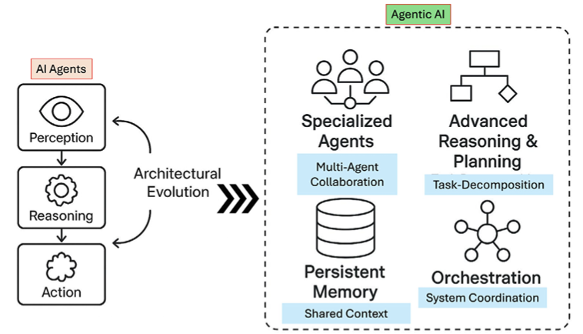
Architectural Evolution and Conceptual Taxonomy – AI Agents vs Agentic AI
AI Agents
Perception
Basic Learning and Adaptation.
Action Selection and Execution Module.
Agentic AI
Specialized Agents.
Advanced Reasoning and Planning.
Persistent Memory Architectures.
Orchestration.
Fig 3. Illustrating architectural evolution from traditional AI Agents to modern Agentic AI systems.

Slide 5
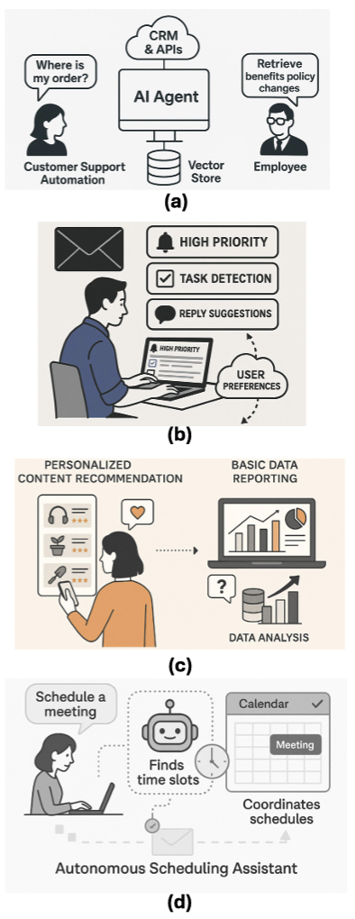
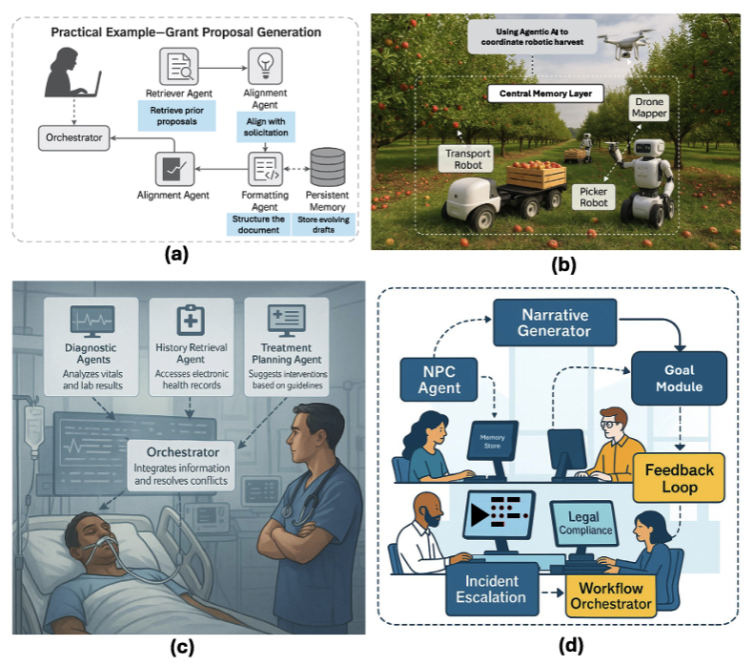
Applications of AI Agents vs Agentic AI
Fig 5. Applications of Agentic AI across domains.
Fig 4. Applications of AI Agents in enterprise settings.

Slide 6
Challenges and Future Solutions
Challenges of AI Agent:
Lack of casual understanding.
Inherent limitation from LLMs.
Incomplete agentic properties.
Reliability and safety concerns.
Challenges of Agentic AI:
Communication and Coordination Bottlenecks.
Emergent behavior and predictability.
Scalability and Debugging complexity.
Security Risks
Future Solutions:
Retrieval-Augmented Generation (RAG).
Memory Architectures.
Reflexive and Self-Critique Mechanisms.
Governance-Aware Architectures.

Slide 7
Questions
Thank you
Adeyinka Olurin
University of Arkansas at Little Rock
Donaghey College of Computer Science, Technology, Engineering, and Mathematics.

